Slide 1

SITA3008
INTERNET OF THINGS

Slide 2
UNIT I – INTRODUCTION TO IOT
UNIT II - ELEMENTS OF IOT
UNIT III - COMMUNICATION AND CONNECTIVE TECHNOLOGIES
UNIT IV - DATA ANALYTICS AND IOT PLATFORM
UNIT V - HANDS-ON PROJECTS

Slide 3
UNIT IV
Big Data Analytics
Architecture
Apache Hadoop
Using Hadoop MapReduce for Batch Data Analysis
Apache Storm
Data Visualization and Visualization tools for IoT

Slide 4
What is Big Data?
Big data is a term that describes the large volume of data – both structured and unstructured – that inundates a business on a day-to-day basis.
Big data can be analyzed for insights that lead to better decisions and strategic business moves.

Slide 5
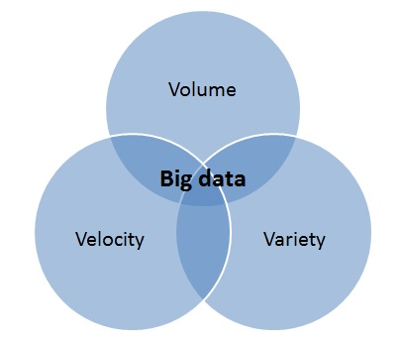
Characteristics of Big data

Slide 6
Big Data is often defined in terms of "3V's”
Volume
Variety
Velocity
In addition, other "V's" may be added including:
Variability
Veracity

Slide 7
Analytics
Analytics is the scientific process of discovering and communicating the meaningful patterns which can be found in data.
Analytics relies on the application of statistics, computer programming, and operations research in order to quantify and gain insight to the meanings of data.

Slide 8
Types of Analytics
Descriptive
Diagnostic
Predictive
Prescriptive
Decisive

Slide 9
Challenges for IoT Big Data
Number of IoT devices
Variety of IoT devices
Intelligence of IoT devices
Risk of IoT device malfunction
Update frequency
Historical data
Context data
Privacy issues

Slide 10
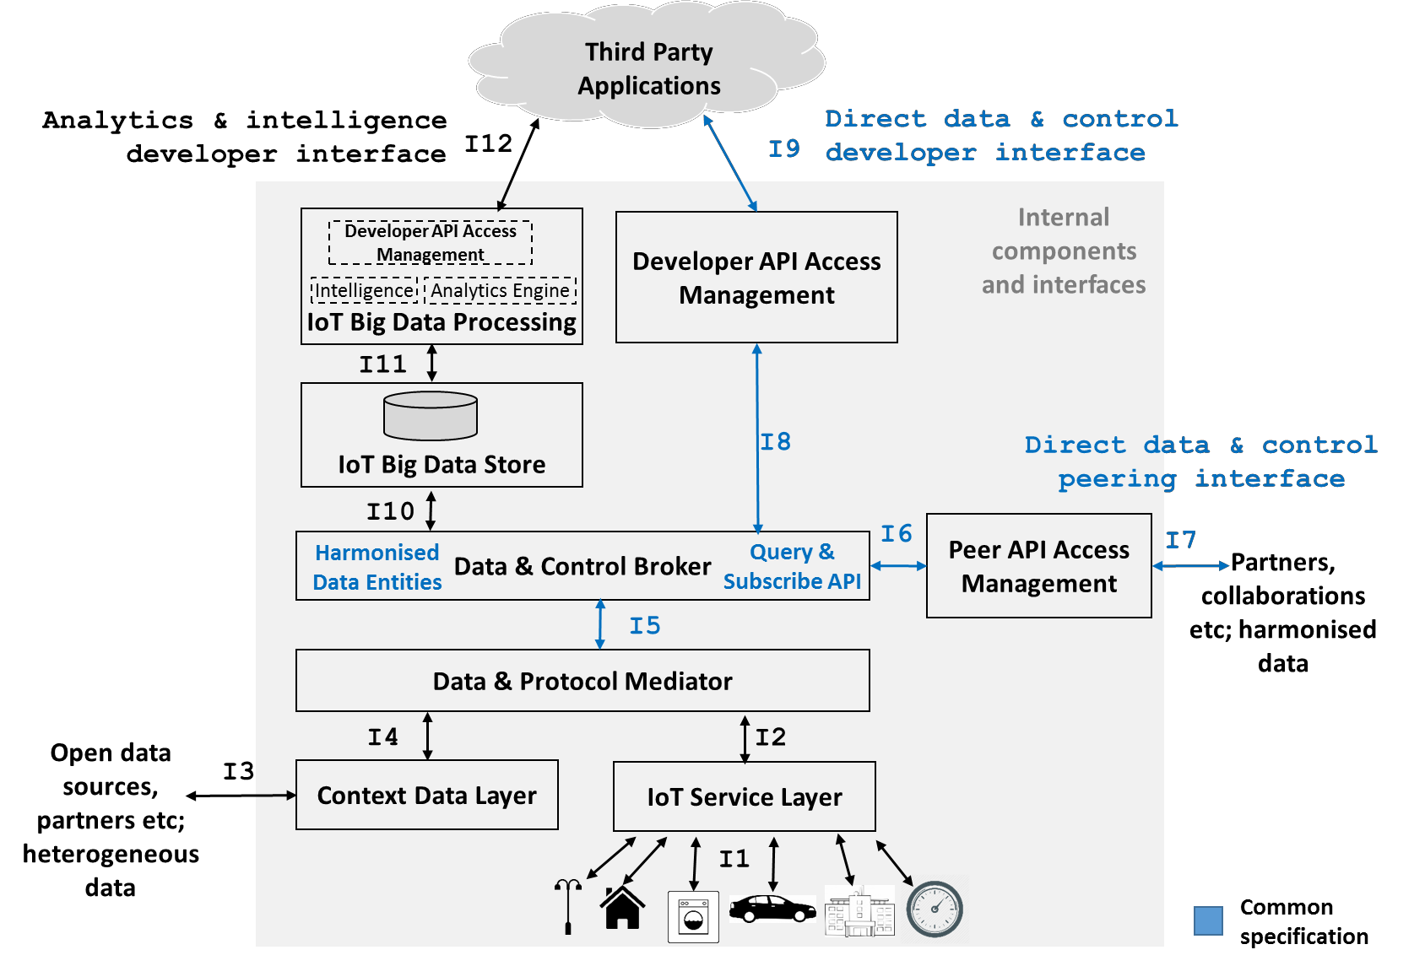
General Architecture for IoT Big Data

Slide 11
IoT Service Layer
The IoT service layer is concerned with handling the device specific interactions required for obtaining data from IoT devices and sending control commands (where relevant) to those IoT devices.
Therefore this layer is required to handle bi-directional communications both to IoT devices and to the upper layers of the architecture

Slide 12
Data and Protocol Mediator
The Data and Protocol Mediator is responsible for ingesting information from IoT devices as well as other external sources ("context data").
It ensures that data is transformed to the Harmonised Entity Definition before being stored and published by the Data & Control Broker.

Slide 13
Data & Control Broker
The Data & Control Broker is responsible for enabling third party application access to harmonised data entities through a query and subscribe API, allowing applications to gain access to such data in a standard way.
The broker may store data in the short to medium term, coming from multiple devices and data sources via the Data and Protocol Mediator.
This function also transforms control requests coming from the application layer to be passed onwards to the Data & Protocol Mediator

Slide 14
Peer API Access Management
The Peer API Access Management function is responsible for interfacing with its peers in other organisations to receive and publish additional relevant harmonised IoT and context data.
The policies applied to these trusted interfaces may be different to those applied to the main developer interface provided by the Developer API Access Management function.

Slide 15
Developer API Access Management
The Developer API Access Management function controls access to harmonised data entities, covering both IoT and context data, as well as control services to third party applications.
It implements authentication, authorisation and access control using industry standards to ensure privacy and security around the harmonised data.

Slide 16
IoT Big Data Store
The provision of Big Data Analytics and Intelligence is dependent on having access to the relevant mass of data from which the various insights can be obtained.
This function provides data storage for this massive data and it may also provide short to medium term storage capabilities for use by the Data & Control Broker, depending on the specific implementation

Slide 17
IoT Big Data Processing
The processing of stored IoT data to perform analytics and intelligence is identified as the responsibility of the IoT Big Data Processing function.
The IoT Big Data Processing function also provides related Developer API Access Management to control access to the intelligence and analytics by implementing authentication, authorisation and access control to ensure privacy and security.

Slide 18
Relevant products for Analytics & Intelligence
Apache Spark
Apache Spark is a powerful data processing system based upon Cassandra or Hadoop for the data storage component and provides several powerful tools for building applications around it such as an SQL interface, graph data library and a job server

Slide 19
Relevant products for Analytics & Intelligence
Apache TinkerPop3 + Titan + Elastic Search + Gremlin
Titan provides Casandra backends, integration with Elastic search, Apache Lucene / Solr, Spark and others which allows it to support Geo searches, full text searches, graph traversals and regular 'SQLesque' queries making it ideal for the IoT Big Data project.

Slide 20
Relevant products for Analytics & Intelligence
Tensorflow
Another open source set of tools for machine learning - developed originally by the Google Brain Team to support advances in search ranking algorithms as well as other Google research activities.

Slide 21
Relevant products for Analytics & Intelligence
Apache Mahout
Mahout is designed for the development of high performance and scalable machine learning applications. It builds for example on top of Apache Spark / Hadoop and supports a range of machine learning algorithms

Slide 22
Big Data Analytical Tools Classification
• Data Storage and Management
• Data Cleaning
• Data Mining
• Data Analysis

Slide 23
Data Storage and Management
Hadoop
Cassandra
Cloudera
MongoDB
Graph Databases

Slide 24
Data Cleaning Tool
OpenRefine
Data Cleaner.

Slide 25
Data Mining Tool
IBM SPSS Modeler
Oracle data mining
FramedData

Slide 26
Data Analysis Tool
Qubole
BigML
Statwing

Slide 27
Apache Hadoop
Hadoop
1. Hadoop is an open source framework that supports the processing of large data sets in a distributed computing environment.
2. Hadoop consists of MapReduce, the Hadoop distributed file system (HDFS) and a number of related projects such as Apache Hive, HBase and Zookeeper. MapReduce and Hadoop distributed file system (HDFS) are the main component of Hadoop.

Slide 28
Apache Hadoop
Hadoop
3. Apache Hadoop is an open-source, free and Java based software framework offers a powerful distributed platform to store and manage Big Data.
4. It is licensed under an Apache V2 license.
5. It runs applications on large clusters of commodity hardware and it processes thousands of terabytes of data on thousands of the nodes.

Slide 29
Use of Hadoop
1. Robust and Scalable
2. Affordable and Cost Effective
3. Adaptive and Flexible
4. Highly Available and Fault Tolerant

Slide 30
Core Hadoop Components
Hadoop MapReduce
Hadoop Distributed File System (HDFS)
Namenode
Secondary Namenode
DataNode
Job Tracker
Task Tracker

Slide 31
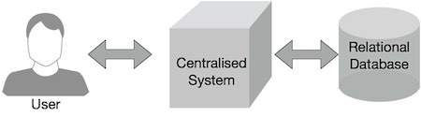
Why MapReduce?

Slide 32
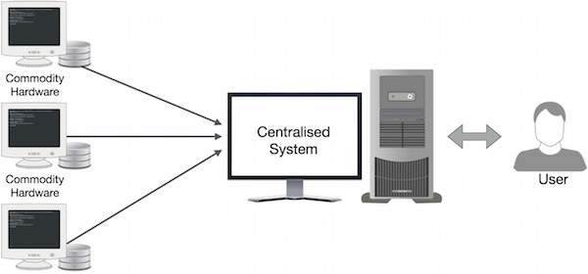

Slide 33
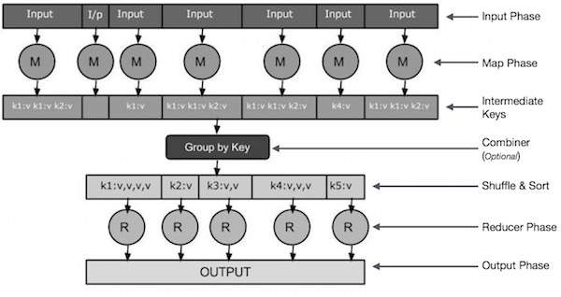
How MapReduce Works?

Slide 34
Input Phase
Map
Intermediate Keys
Combiner
Shuffle and Sort
Reducer
Output Phase
How MapReduce Works?

Slide 35
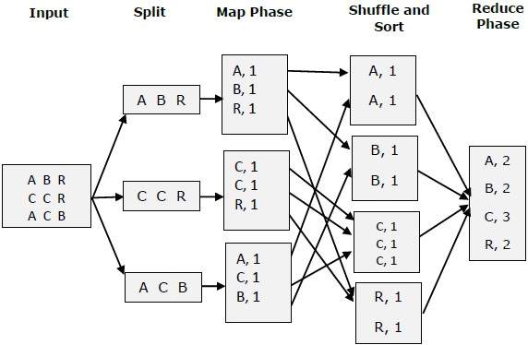

Slide 36
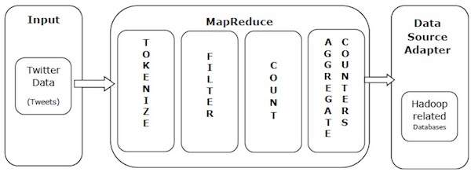
MapReduce-Example

Slide 37
MapReduce-Example
Tokenize − Tokenizes the tweets into maps of tokens and writes them as key-value pairs.
Filter − Filters unwanted words from the maps of tokens and writes the filtered maps as key-value pairs.
Count − Generates a token counter per word.
Aggregate Counters − Prepares an aggregate of similar counter values into small manageable units.

Slide 38
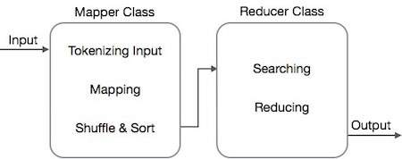

Slide 39
The MapReduce algorithm contains two important tasks, namely Map and Reduce.
The map task is done by means of Mapper Class
The reduce task is done by means of Reducer Class.

Slide 40
Apache Storm
What is Apache Storm?
Apache Storm is a distributed real-time big data-processing system.
Storm is designed to process vast amount of data in a fault-tolerant and horizontal scalable method.
It is a streaming data framework that has the capability of highest ingestion rates.
Though Storm is stateless, it manages distributed environment and cluster state via Apache ZooKeeper.
It is simple and you can execute all kinds of manipulations on real-time data in parallel.

Slide 41
Apache Storm vs Hadoop
Apache Hadoop | Apache Storm
Distributed Batch processing of large volume and unstructured dataset. | Distributed real-time processing of data having a large volume and high velocity.
Framework is written in Java. | Storms is written in Half Java and Half Clojure code, but a majority of code/logic is written in Clojure.
It is Stateful streaming processing. | It is Stateless streaming processing.
It uses Apache Zookeeper coordination. | It may or may not uses Apache Zookeeper for coordination.
MapR jobs are executed in a sequential manner still it is completed. | Storm topology runs continuously until system shutdown.
It has High Latency (Slow Computation). | It has Low Latency (Fast Computation).
Architecture is based on a topology of Spouts and bolts. | Architecture consists of HDFS and MapReduce.
Data is continuously streamed and it is dynamic. | Data is static and nonvolatile (Data is Persistence).
It is easy to setup but operating Hadoop cluster is difficult. | It is easy to setup and operating storm cluster is also easy.
Use Cases: Twitter, Navisite, Wego etc. | Use Cases: Black Box Data, Search Engine Data etc.

Slide 42
Apache Storm is very famous for real-time big data stream processing.
For this reason, most of the companies are using Storm as an integral part of their system. Some notable examples are as follows −
Twitter
NaviSite
Wego

Slide 43
Apache Storm Benefits
Open source, robust, and user friendly
It is fault tolerant, flexible, reliable, and supports any programming language.
Allows real-time stream processing.
It is unbelievably fast
It can keep up the performance
It performs data refresh and end-to-end delivery response in seconds or minutes
It has operational intelligence.

Slide 44
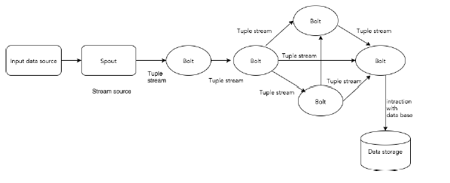

Slide 45
Components | Description
Tuple | Tuple is the main data structure in Storm. It is a list of ordered elements. By default, a Tuple supports all data types. Generally, it is modelled as a set of comma separated values and passed to a Storm cluster.
Stream | Stream is an unordered sequence of tuples.
Spouts | Source of stream. Generally, Storm accepts input data from raw data sources like Twitter Streaming API, Apache Kafka queue, Kestrel queue, etc. Otherwise you can write spouts to read data from datasources. “ISpout" is the core interface for implementing spouts. Some of the specific interfaces are IRichSpout, BaseRichSpout, KafkaSpout, etc.
Bolts | Bolts are logical processing units. Spouts pass data to bolts and bolts process and produce a new output stream. Bolts can perform the operations of filtering, aggregation, joining, interacting with data sources and databases. Bolt receives data and emits to one or more bolts. “IBolt” is the core interface for implementing bolts. Some of the common interfaces are IRichBolt, IBasicBolt, etc.

Slide 46
Let’s take a real-time example of “Twitter Analysis” and see how it can be modeled in Apache Storm.
The following diagram depicts the structure

Slide 47
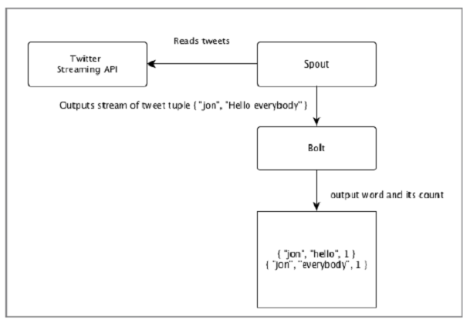

Slide 48
Topology
Spouts and bolts are connected together and they form a topology.
A simple topology starts with spouts. Spout emits the data to one or more bolts.
Bolt represents a node in the topology having the smallest processing logic and the output of a bolt can be emitted into another bolt as input.
Storm keeps the topology always running, until you kill the topology.
Apache Storm’s main job is to run the topology and will run any number of topology at a given time.

Slide 49
Tasks
In simple words, a task is either the execution of a spout or a bolt.
At a given time, each spout and bolt can have multiple instances running in multiple separate threads.

Slide 50
Workers
A topology runs in a distributed manner, on multiple worker nodes.
Storm spreads the tasks evenly on all the worker nodes.
The worker node’s role is to listen for jobs and start or stop the processes whenever a new job arrives

Slide 51
Stream Grouping
Stream of data flows from spouts to bolts or from one bolt to another bolt.
Stream grouping controls how the tuples are routed in the topology and helps us to understand the tuples flow in the topology.

Slide 52
There are four in-built groupings
Shuffle grouping
Field Grouping
Global Grouping
All Grouping

Slide 53
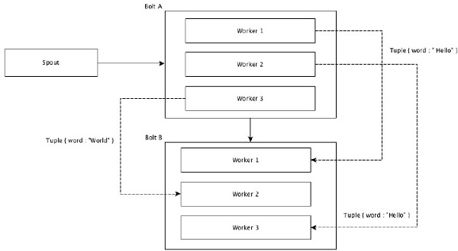
Shuffle grouping

Slide 54
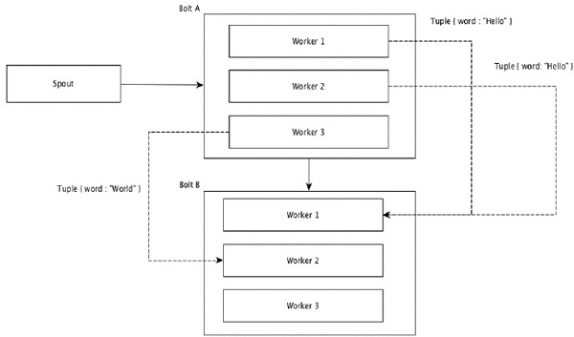
Field Grouping

Slide 55
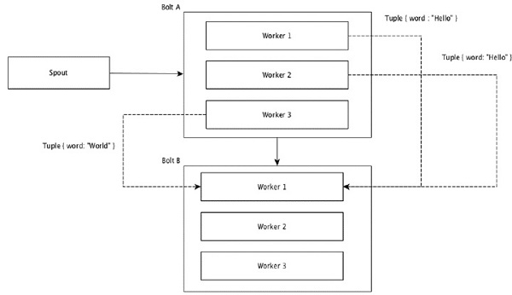
Global Grouping

Slide 56
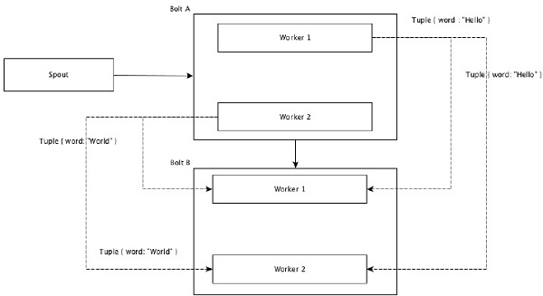
All Grouping

Slide 57
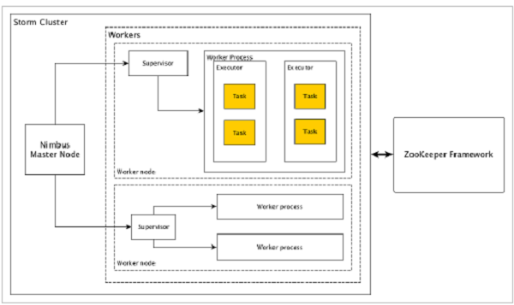
Apache Storm internal architecture

Slide 58
Components | Description
Nimbus | Nimbus is a master node of Storm cluster. All other nodes in the cluster are called as worker nodes. Master node is responsible for distributing data among all the worker nodes, assign tasks to worker nodes and monitoring failures.
Supervisor | The nodes that follow instructions given by the nimbus are called as Supervisors. A supervisor has multiple worker processes and it governs worker processes to complete the tasks assigned by the nimbus.
Worker process | A worker process will execute tasks related to a specific topology. A worker process will not run a task by itself, instead it creates executors and asks them to perform a particular task. A worker process will have multiple executors.
Executor | An executor is nothing but a single thread spawn by a worker process. An executor runs one or more tasks but only for a specific spout or bolt.
Task | A task performs actual data processing. So, it is either a spout or a bolt.
ZooKeeper framework | Apache ZooKeeper is a service used by a cluster (group of nodes) to coordinate between themselves and maintaining shared data with robust synchronization techniques. Nimbus is stateless, so it depends on ZooKeeper to monitor the working node status. ZooKeeper helps the supervisor to interact with the nimbus. It is responsible to maintain the state of nimbus and supervisor.

Slide 59
Workflow of Apache Storm
Initially, the nimbus will wait for the “Storm Topology” to be submitted to it.
Once a topology is submitted, it will process the topology and gather all the tasks that are to be carried out and the order in which the task is to be executed.
Then, the nimbus will evenly distribute the tasks to all the available supervisors.
At a particular time interval, all supervisors will send heartbeats to the nimbus to inform that they are still alive.
When a supervisor dies and doesn’t send a heartbeat to the nimbus, then the nimbus assigns the tasks to another supervisor

Slide 60
Workflow of Apache Storm
When the nimbus itself dies, supervisors will work on the already assigned task without any issue.
Once all the tasks are completed, the supervisor will wait for a new task to come in.
In the meantime, the dead nimbus will be restarted automatically by service monitoring tools.
The restarted nimbus will continue from where it stopped.
Once all the topologies are processed, the nimbus waits for a new topology to arrive and similarly the supervisor waits for new tasks

Slide 61
There are two modes in a Storm cluster −
Local mode − This mode is used for development, testing, and debugging because it is the easiest way to see all the topology components working together.
Production mode − In this mode, we submit our topology to the working storm cluster, which is composed of many processes, usually running on different machines.

Slide 62
What is Distributed Messaging System?
Distributed messaging is based on the concept of reliable message queuing.
Messages are queued asynchronously between client applications and messaging systems.
A distributed messaging system provides the benefits of reliability, scalability, and persistence

Slide 63
What is Distributed Messaging System?
Most of the messaging patterns follow the publish-subscribe model (simply Pub-Sub) where the senders of the messages are called publishers and those who want to receive the messages are called subscribers.
Once the message has been published by the sender, the subscribers can receive the selected message with the help of a filtering option. Usually we have two types of filtering, one is topic-based filtering and another one is content-based filtering

Slide 64
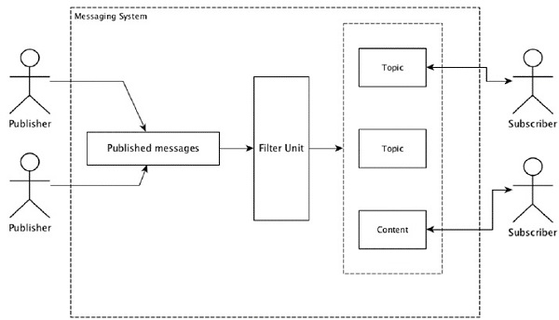

Slide 65
Distributed messaging system | Description
Apache Kafka | Kafka was developed at LinkedIn corporation and later it became a sub-project of Apache. Apache Kafka is based on brokerenabled, persistent, distributed publish-subscribe model. Kafka is fast, scalable, and highly efficient.
RabbitMQ | RabbitMQ is an open source distributed robust messaging application. It is easy to use and runs on all platforms.
JMS(Java Message Service) | JMS is an open source API that supports creating, reading, and sending messages from one application to another. It provides guaranteed message delivery and follows publish-subscribe model.
ActiveMQ | ActiveMQ messaging system is an open source API of JMS.
ZeroMQ | ZeroMQ is broker-less peer-peer message processing. It provides push-pull, router-dealer message patterns.
Kestrel | Kestrel is a fast, reliable, and simple distributed message queue.

Slide 66
Thrift Protocol
Thrift was built at Facebook for cross-language services development and remote procedure call (RPC). Later, it became an open source Apache project.
Apache Thrift is an Interface Definition Language and allows to define new data types and services implementation on top of the defined data types in an easy manner.

Slide 67
Data Visualization
Data visualization is the visual and interactive exploration and graphic representation of data of any size, type (structured and unstructured) or origin.
Visualizations help people see things that were not obvious to them before. Even when data volumes are very large, patterns can be spotted quickly and easily.
Visualizations convey information in a universal manner and make it simple to share ideas with others.

Slide 68
Data Visualization Tools
Various tools have emerged to help us out from the above pointed problems.
The most important feature that a visualization must have is that it should be interactive, which means that user should be able to interact with the visualization.
Visualization must display relevant information when hovered over it, zoom in and out panel should be there, visualization should adapt itself at runtime if we select subset or superset of data

Slide 69
Tableau
Tableau is interactive data visualization tool which is focused on Business Intelligence.
Tableau provides very wide range of visualization options.
It provides option to create custom visualization.
It is fast and ﬂexible.
It supports mostly all the data format and connection to various servers right from the Amazon Aurora to Cloudera Hadoop and Salesforce

Slide 70
Some other important big data visualization problems are as follows
Visual noise: Most of the objects in dataset are too relative to each other. It becomes very difﬁcult to separate them.
Information loss: To increase the response time we can reduce data set visibility, but this leads to information loss.
Large image perception: Even after achieving desired me- chanical output we are limited by our physical perception.

Slide 71
Microsoft Power BI
Power BI is a powerful cloud-base business analytics service. Visualization are interactive and rich.
Power BI consists of 3 elements, Power BI Desktop, Service(SaaS), Apps.
Every service is available to us that is why it makes Power BI ﬂexible and persuasive.
With more than 60 types of source integration you can start creating visualization in matter of minutes.
Power BI combines the familiar Microsoft tools like Ofﬁce, SharePoint and SQL Server.
The feature that it distinguishes from other tools is that you can use natural language to query the data.

Slide 72
Microsoft Power BI
You can merge multiple data sources and create models, which comes in handy.
Figure represents 3 visualizations in 3 coordinates, i.e. left, bottom and right.
Left represents proﬁt by county and market, bottom represents proﬁt by region and right coordinate represents all over sales and proﬁt

Slide 73
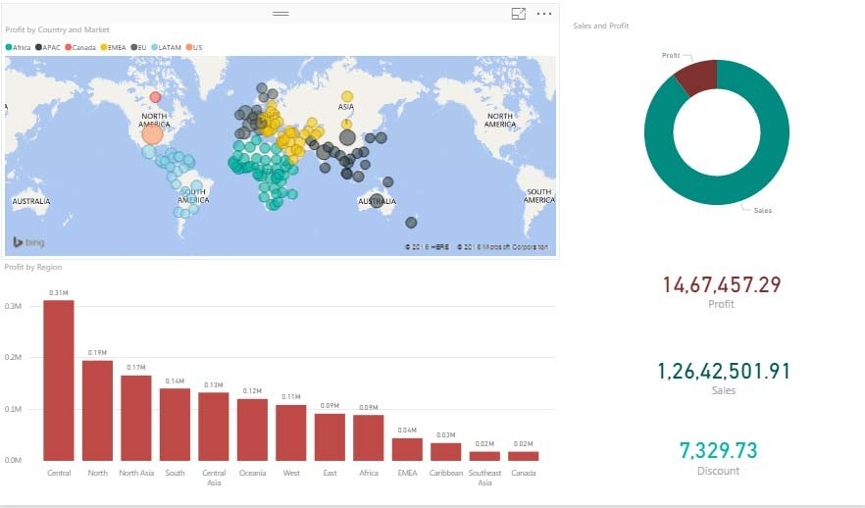

Slide 74
Plotly
Plotly is also known as Plot.ly is build using python and Django framework.
The actions it can perform are analyzing and visualizing data. It is free for users but with limited features, for all the features we need to buy the professional membership.
It creates charts and dashboards online but can be used as ofﬂine service inside Ipython notebook, jupyter notebook and panda.
Different variety of charts are available like statistical chart, scientiﬁc charts, 3D charts, multiple axes, dashboards etc.

Slide 75
Plotly
Plotly uses a tool called “Web Plot Digitizer(WPD)” which automatically grabs the data from the static image .
Plotly on premises service is also available, it is like plot.ly cloud but you host data on your private cloud behind your own ﬁrewall.
This for those who have concern about the privacy of their data.
Python, R, MATLAB and Julia APIs are available for the same.

Slide 76
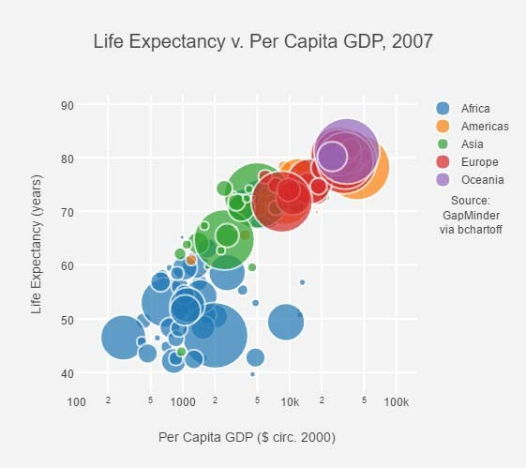

Slide 77
Gephi
Gephi is open-source network analysis tool written in Java and OpenGL.
It is used to handle very large and complex datasets.
The network analysis includes.

Slide 78
Social Network Analysis
Link Analysis
Biological Network Analysis
With its dynamic data exploration Gephi stands out rest of its competition for graph analysis.
No programming skills are required to run thin tools but a good knowledge in graphs is necessary.
It uses GPU 3D render engine to accelerate the performance and give real time analysis

Slide 79
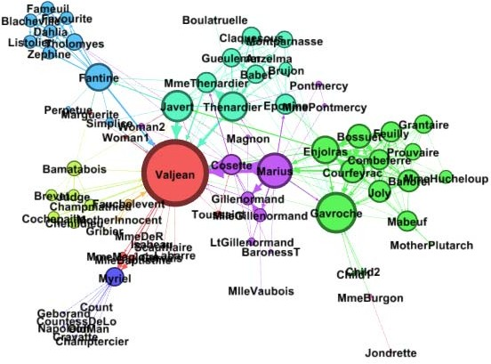

Slide 80
Excel 2016
Microsoft Excel is a spreadsheet developed by Microsoft.
It can not only be used for Big Data and statistical analysis but it is also a powerful visualization tool.
Using power query excel can connect to most of the services like HDFS, SaaS etc and is capable of managing Semi- Structured data.
Combined with visualization techniques like ”Conditional Formatting” and interactive graphs makes Excel 2016 a good contender in the ocean of Big Data visualization tools

Slide 81
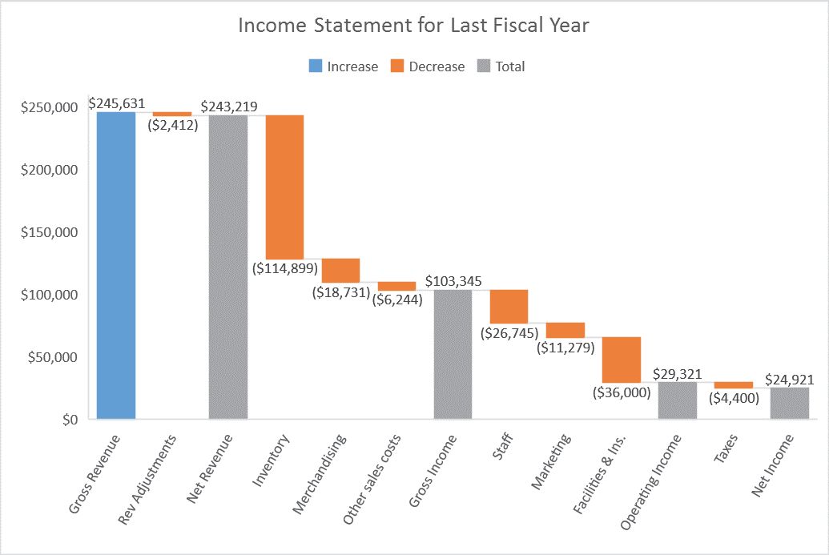

Slide 82
Excel 2016
Microsoft Excel is a spreadsheet developed by Microsoft.
It can not only be used for Big Data and statistical analysis but it is also a powerful visualization tool.
Using power query excel can connect to most of the services like HDFS, SaaS etc and is capable of managing Semi- Structured data.
Combined with visualization techniques like ”Conditional Formatting” and interactive graphs makes Excel 2016 a good contender in the ocean of Big Data visualization tools

Slide 83
Oracle Visual Analyzer
Introduced in 2015, this web-based tool within the Oracle Business Intelligence Cloud Service claimed a spot at the Magic Quadrant Business Intelligence and Analytics Platform report by Gartner.
Interactive visuals and highly advanced analysis clubbed with a customizable dashboard are some of the key features of Oracle Visual Analyzer.
Being highly scalable, this data visualization tool is very suitable for enterprises with large-scale deployments where deep insights and well curated reports are essential.

Slide 84
Datawrapper
Datawrapper is a data visualization tool that’s gaining popularity fast, especially among media companies which use it for presenting statistics and creating charts.
It has an easy to navigate user interface where you can easily upload a csv file to create maps, charts and visualizations that can be quickly added to reports.
Although the tool is primarily aimed at journalists, it’s flexibility should accommodate a host of applications apart from media usage

Slide 85
Google Chart
Google is an obvious benchmark and well known for the user-friendliness offered by its products and Google chart is not an exception.
It is one of the easiest tools for visualizing huge data sets.
Google chart holds a wide range of chart gallery, from a simple line graph to complex hierarchical tree-like structure and you can use any of them that fits your requirement.
Moreover, the most important part while designing a chart is customization and with Google charts, it’s fairly Spartan.

Slide 86
Google Chart
You can always ask for some technical help if you want to dig deep.
It renders the chart in HTML5/SVG format and it is cross-browser compatible. Added to this, it also has adopted VML for supporting old IE browsers and that’s also cross-platform compatible, portable to iOS and the new release of Android.
The chart data can be easily exported to PNG format

Slide 87
Qlikview
Qlik is one of the major players in the data analytics space with their Qlikview tool which is also one of the biggest competitors of Tableau.
Qlikview boasts over 40,000 customers spanning across over 100 countries.
Qlik is particularly known for its highly customizable setup and a host of features that help create the visualizations much faster.

Slide 88
Qlikview
However, the available options could mean there would be a learning curve to get accustomed with the tool so as to use it to its full potential.
Apart from its data visualization prowess, Qlikview also offers analytics, business intelligence and enterprise reporting features.
The clean and clutter-free user experience is one of the notable aspects of Qlikview.

Slide 89
Qliksense is a sister package of Qlikview which is often used alongside the former to aid in data exploration and discovery.
Another advantage of using Qlikview is the strong community of users and resources which will help you get started with the tool

Slide 90
THANK YOU

